Slide 1
INSIDER: Designing In-Storage Computing System for Emerging High-Performance Drive
Conference : ATC ' 19
Author : Zhenyuan Ruan, Tong He, Jason Cong
Research unit : University of California, Los Angeles

Slide 2
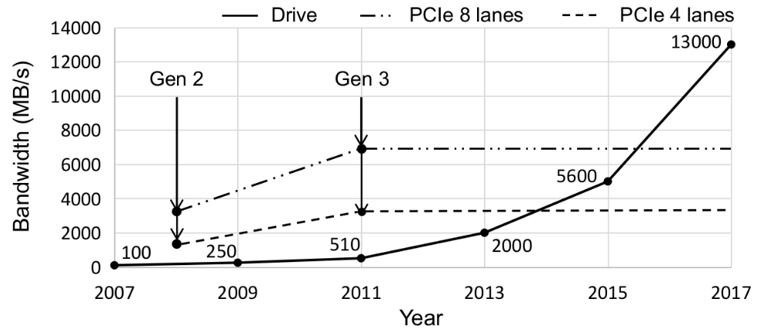
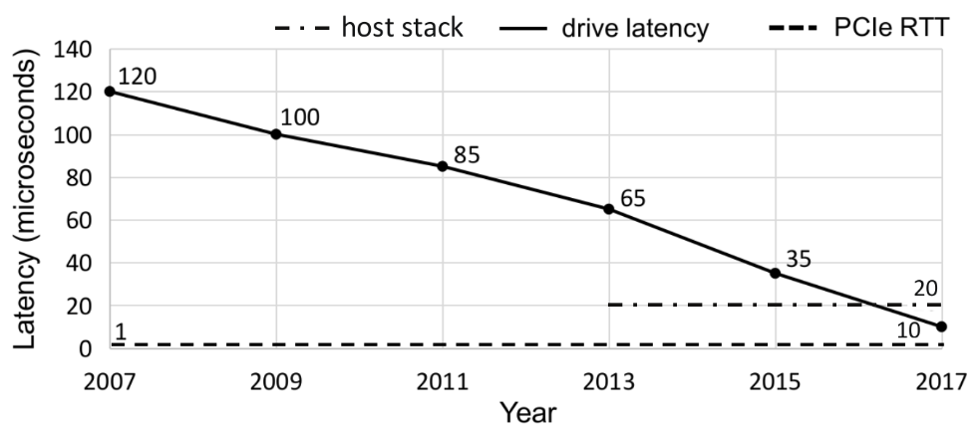
Background
The bandwidth and latency of storage drives have improved significantly within the past decade. However, the evolution of the interconnection bus remains stagnant: there have been only two updates between 2007 and 2017.
Fig2 shows that the latencies of host-side I/O stack are going to dominate the end-to-end latency.
Notes:
驱动器的带宽和延迟性能迅速提升，但互联总线的性能增长缓慢
主机端I/O栈的延迟将主导端到端延迟

Slide 3
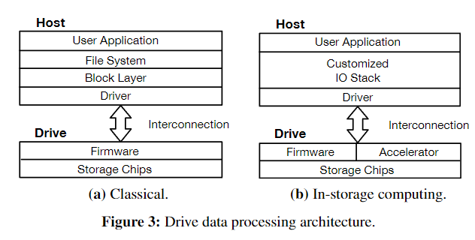
Background
In ISC, the host partially offloads tasks into the in-storage accelerator which can take advantage of the higher internal drive performance.
For tasks that contain computation patterns like filtering or reduction, the output data volume of the accelerator is greatly reduced so that bottlenecks of interconnection and host I/O stacks are alleviated.
With customized IO stacks, the system bypasses the traditional OS storage stacks to achieve lower latency.
Notes:
传统架构
传统上，驱动器被认为是辅助持久存储的慢速设备，与DRAM相比，它具有更高的访问延迟(以毫秒计)和更低的带宽(以每秒数百MB计)。
基于此，图3a所示的经典存储数据处理架构，几十年来一直满足用户的性能要求。该架构的基本假设是:1)互连性能高于驱动器性能。2)主机端I/O栈的执行速度，包括block device driver、I/O scheduler、generic block layer和文件系统，要比驱动器访问快得多。
ISC架构
在ISC中，主机将部分任务卸载到存储加速器中，这可以利用更高的内部驱动器性能，但与成熟的主机CPU相比，它的功能相对较弱。
对于包含过滤或缩减等计算模式的任务，加速器的输出数据量大大减少，这些数据将通过互联传输回主机，从而缓解互联和主机I/O栈的瓶颈
通过定制的IO栈，系统绕过了传统的OS存储栈，以实现更低的延迟。

Slide 4
Problem
Limited computing capability.
Drive-embedded cores are originally designed to execute the drive firmware; they are generally too weak for in-storage computing (ISC).
No effective programming abstractions.
On the host side, existing systems develop their own customized API for ISC, which is not compatible with an existing system interface like POSIX.
Requires considerable host code modification to leverage the drive ISC capability.
Lack of crucial system support.
Not consider data protection and multiple task.
Existing work assumes a monopolized scenario; the isolation and resource scheduling between different ISC tasks are not explored.
Notes:
最近的大部分工作都集中在将用户定义的任务卸载到驱动嵌入式cpu上，这些cpu最初是用来执行固件代码的，例如闪存翻译层(FTL)
驱动嵌入式CPU通常是相当弱的ARM内核对于isc来说太弱了
现有的工作没有为程序员提供有效的抽象。在主机端，他们为ISC开发了自己的定制API，这与现有的系统接口(如POSIX)不兼容。这需要大量的主机代码修改来利用驱动器ISC功能。
缺乏关键的系统支持。
驱动器是在多个进程之间共享的，这意味着需要并发执行多个ISC应用程序。这对于新兴的存储驱动器尤其重要，因为单个应用程序可能无法完全饱和高速驱动器。保护、隔离和带宽调度提供支持至关重要。
在没有数据保护的情况下，恶意或错误的ISC任务可能会对未经授权的数据进行操作;如果没有隔离，一个ISC任务的执行可能会影响其他ISC任务的执行，甚至影响固件的执行;在没有带宽调度的情况下，一些ISC任务可能会强行占用驱动器，影响公平性和活性

Slide 5
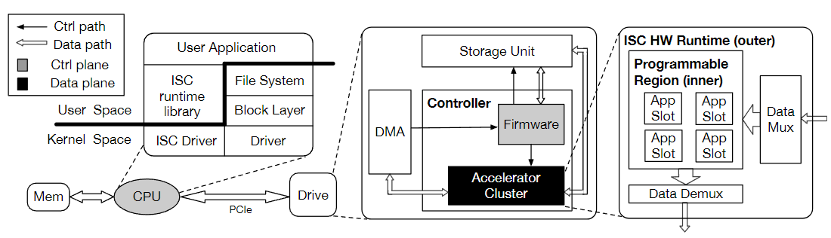
Solution & Technique
System architecture of INSIDER
The firmware cooperates with the host-side ISC runtime and the ISC driver to enforce the control plane execution. It receives the incoming drive access requests from host, converts their logical block addresses into physical block addresses, and finally issues the requests to the storage unit.
The control plane takes the responsibilities of conducting file permission check at host and issuing drive accessing requests.
The accelerator cluster intercepts and processes the data between the DMA controller and the storage chip. It only passively processes the intercepted data from other components.
Notes:
INSIDER将控制平面和数据平面分开 Accelerator 在数据平面，cpu和firmware在控制平面。固件与主机端ISC运行时和ISC驱动协同执行控制平面
firmware接收来自主机的传入驱动器访问请求，将其逻辑块地址转换为物理块地址，最后将请求发送给存储单元。
控制平面负责对主机进行文件权限检查，并发出驱动器访问请求
加速器集群被分离到数据平面。它不需要考虑从存储芯片的哪里读取(写入)数据。相反，它拦截和处理DMA控制器和存储芯片之间的数据。
防止驱动器数据被未经授权的驱动器程序访问。
此外，纯计算抽象为加速器集群带来了一个隔离的环境;它的执行不会影响控制平面中其他系统组件的执行。在加速器集群中执行不同的卸载任务被进一步硬件隔离到FPGA资源的不同部分。

Slide 6
Solution & Technique
Accelerator Cluster
The inner layer is a programmable region which consists of multiple application slots. Each slot can accommodate a user-defined application accelerator. Host users can dynamically load a new accelerator to the specified slot.
The outer layer is the hardware runtime which is responsible for performing flow control and dispatching data to the corresponding slots. The outer layer is set to be user-unprogrammable to avoid safety issues.
Notes:
加速器团簇分为两层。内层是由多个应用程序槽组成的可编程区域。每个插槽可以容纳一个用户定义的应用程序加速器。
不同的插槽同时占用不同部分的硬件资源，从而在空间多路复用中共享FPGA
主机用户可以动态地将新的加速器加载到指定槽中。
外层是硬件运行时，负责执行流控制(§3.5)，并将数据分发到相应的槽位(§3.6)。外层设置为用户不可编程，以避免安全问题。

Slide 7
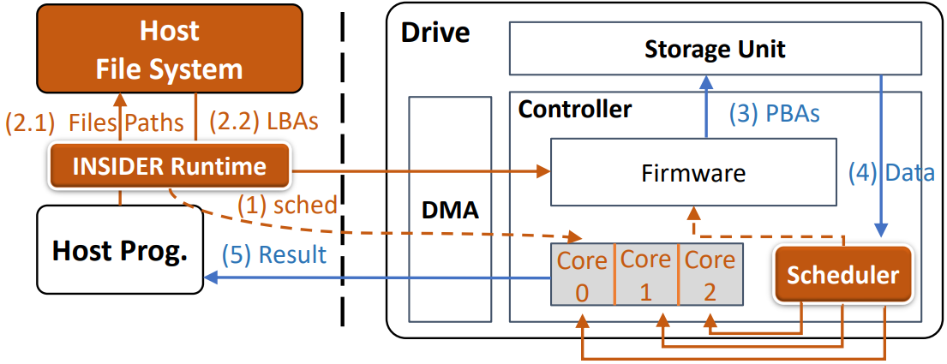
Solution & Technique
System architecture of INSIDER
The firmware cooperates with the host-side ISC runtime and the ISC driver to enforce the control plane execution. It receives the incoming drive access requests from host, converts their logical block addresses into physical block addresses, and finally issues the requests to the storage unit.
The control plane takes the responsibilities of conducting file permission check at host and issuing drive accessing requests.
The accelerator cluster intercepts and processes the data between the DMA controller and the storage chip. It only passively processes the intercepted data from other components.

Slide 8
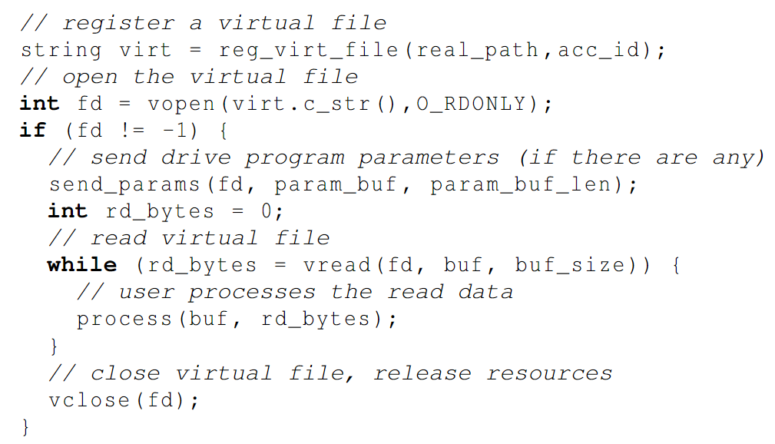
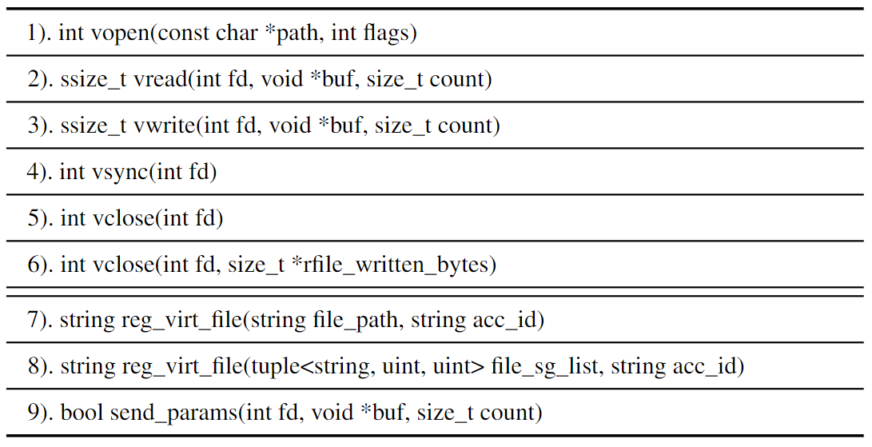
Solution & Technique
The Host-Side Programming Model
On the host side, we provide virtual file abstraction which abstracts ISC as file operations to hide the existence of the underlying ISC unit.
The access to virtual file will transparently trigger the underlying system data movement and the corresponding ISC, creating an illusion that this file does really exist.
Notes:
在主机端，我们提供虚拟文件抽象，它将ISC抽象为文件操作，以隐藏底层ISC单元的存在
对虚拟文件的访问将透明地触发底层系统数据移动和相应的ISC，从而产生该文件确实存在的错觉。
Insider把对虚拟文件的操作实现为右表所示的类POSIX API
注册：将真实文件和加速器id映射到虚拟文件
打开文件：检查访问权限
发送参数：通过send_params发送到drive
通过vread读取预处理好的数据
对数据进行处理
关闭文件

Slide 9
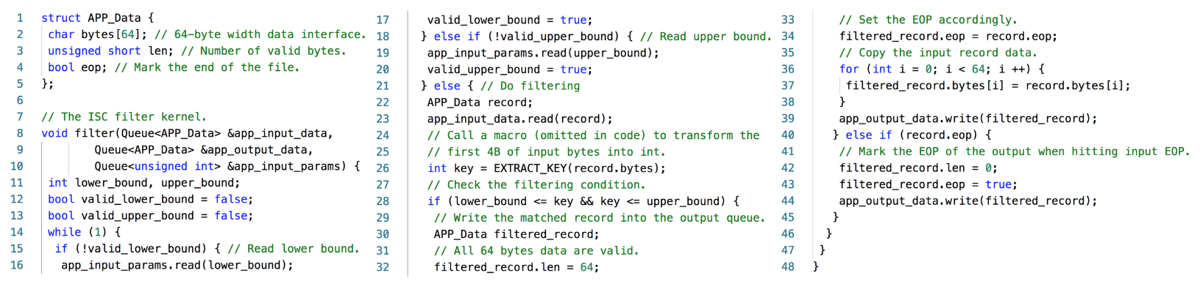
Solution & Technique
The Drive-Side Programming Model
INSIDER defines a clear interface to hide all details of data movements between the accelerator program and other system components so that the device programmer only needs to focus on describing the computation logic.
INSIDER provides a drive-side compiler which allows users to program in-drive accelerators with C++.
INSIDER supports modularity. The user can define multiple sub-programs chained together with FIFOs to form a complete program. Chained sub-programs will be compiled as separate hardware modules by the INSIDER compiler, and they will be executed in parallel.
Notes:
INSIDER定义了一个清晰的接口来隐藏加速程序和其他系统组件之间数据移动的所有细节，这样设备程序员只需要专注于描述计算逻辑
INSIDER提供了一个驱动器端编译器，它允许用户用c++编写驱动器内加速器
内部支持模块化。用户可以定义多个子程序与fifo链接在一起，形成一个完整的程序，链式子程序将被INSIDER编译器编译为独立的硬件模块，它们将并行执行。

Slide 10
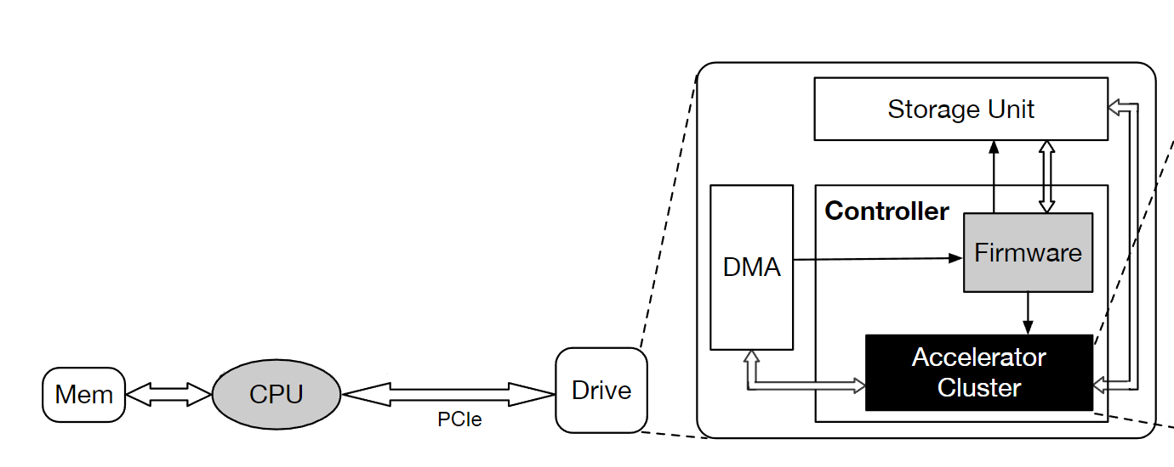
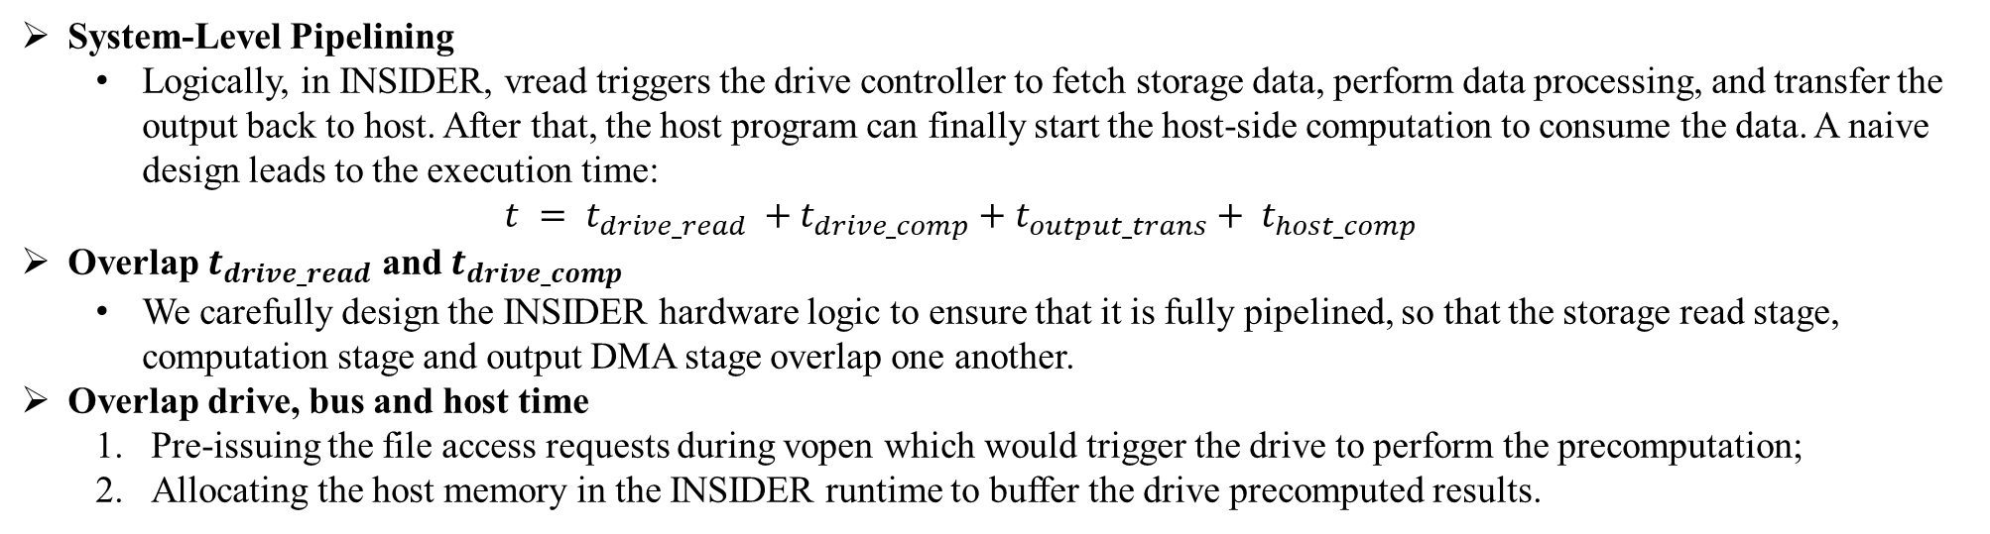
Solution & Technique
System-Level Pipelining
Logically, in INSIDER, vread triggers the drive controller to fetch storage data, perform data processing, and transfer the output back to host. After that, the host program can finally start the host-side computation to consume the data. A naive design leads to the execution time:
$$t = t_{drive_read} +t_{drive_comp}+t_{output_trans}+ t_{host_comp}$$
Overlap $t_{drive_read}$ and $t_{drive_comp}$
We carefully design the INSIDER hardware logic to ensure that it is fully pipelined, so that the storage read stage, computation stage and output DMA stage overlap one another.
Overlap drive, bus and host time
Pre-issuing the file access requests during vopen which would trigger the drive to perform the precomputation;
Allocating the host memory in the INSIDER runtime to buffer the drive precomputed results.
Notes:
逻辑上主机端调用vread的时候才从存储单元获取数据进行预处理，再传输给主机进行计算。
我们精心设计了INSIDER硬件逻辑，确保其完全流水线化，使存储读取阶段、计算阶段和输出DMA阶段相互重叠。
1.在vopen期间预发出文件访问请求，这将触发驱动器执行预计算;
2在INSIDER运行时分配主机内存以缓冲驱动器预计算结果。

Slide 11
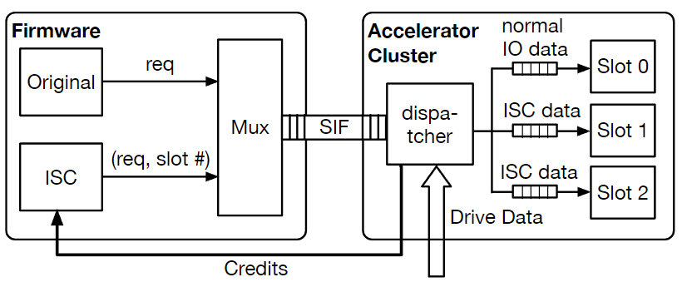
Solution & Technique
Multiplexing.
The multiplexer will receive the request from both the ISC unit and the original firmware.
The received request will be forwarded to the storage unit, and its slot index will be pushed into the Slots Index FIFO(SIF).
After receiving the drive read data, the dispatcher of the accelerator cluster will pop a slot index from SIF and dispatch the data to the application FIFO connected to the corresponding application slot.
Adaptive Scheduling
The ISC unit maintains a set of credit registers (initialized to R) for all offloaded applications.
The ISC unit will check registers of applications that have pending drive access requests, in a round-robin fashion.
If the register of an application is greater than 0, the ISC unit will issue a drive access request in size C with its slot index, and then decrement its credit register.
Each time data is dispatched to the application FIFO, if the available space of that FIFO is greater than C, the dispatcher will release one credit to the corresponding credit register in the ISC unit.
Notes:
原始固件用于像往常一样处理正常的驱动器I/O请求，而ISC单元用于处理与isc相关的驱动器请求
多路选择器将同时接收来自ISC单元和原始固件的请求。接收到的请求将被转发到存储单元(图中未绘制)，其槽位索引将被推入槽位索引FIFO (SIF)
在接收到驱动器读取数据后，加速器集群的调度程序将从SIF弹出一个槽位索引，并将数据分发给连接到相应应用程序槽位的应用程序FIFO。

Slide 12
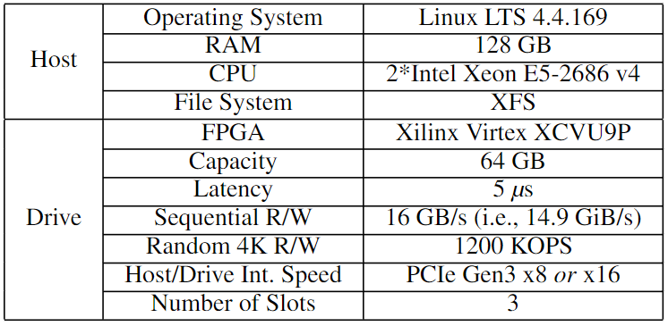
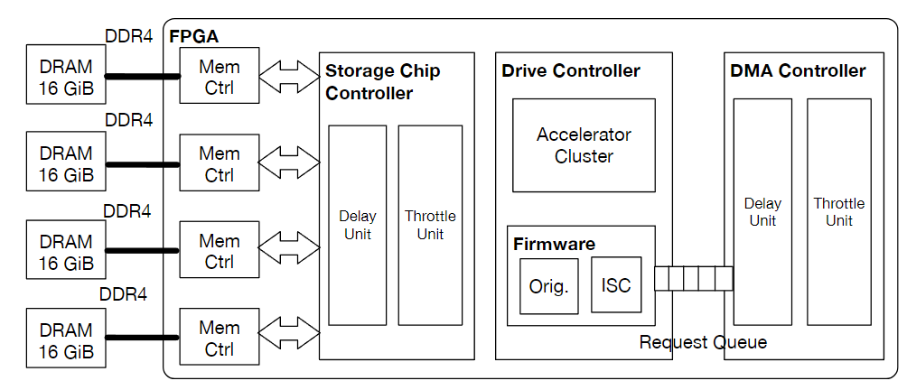
Evaluation
Setup
INSIDER drive prototype

Slide 13
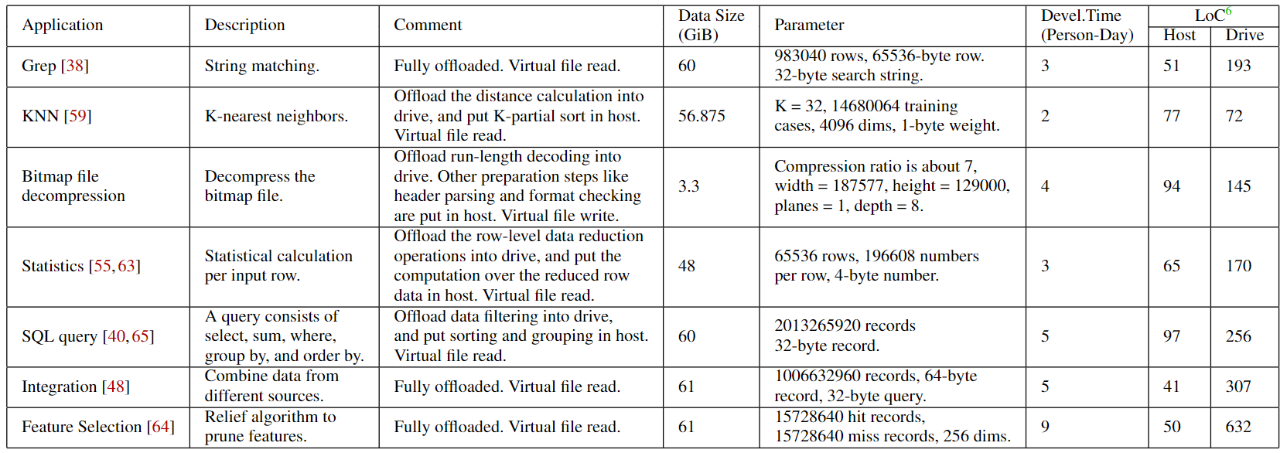
Evaluation
Applications used in the evaluation.
Notes:
grep： 查找文件里符合条件的字符串 grep hello test.txt knn：kNN算法计算不同特征值之间的距离对样本进行分类。
Bitmap file decompression：12W1B12W3B24W1B14W 12个w 1个b…
WW12BWW12BB3WW24BWW14 12个w 1个B 12个W…
statistics：对数据进行统计，如max，min，avg，把每一行数据的统计下放到drive，求每行的max，min，sum
sql query：把数据过滤下放到drive
integration：将不同来源的数据整合在一个数据库中
feature selection：从已有的M个特征(Feature)中选择N个特征使得系统的特定指标最优化，减少数据维度

Slide 14
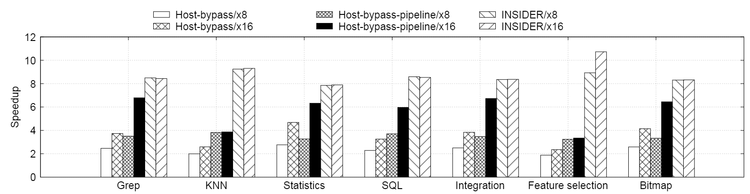
Evaluation
Speedup compare to host-only baseline
Host-bypass: Replace the POSIX interface with the ISC interface to bypass overheads of the host I/O stack.
Host-bypass-pipeline: With the host-side code refactoring, we can conduct pipelining to overlap the computation time and the file access time.
INSIDER: Leverage the ISC capability to offload computing tasks to the drive.

Slide 15
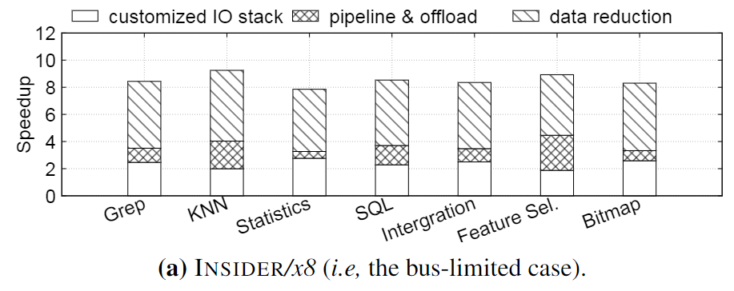
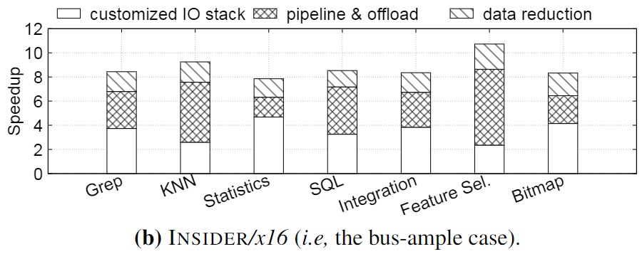
Evaluation
Breakdown of speedup
The speedup of version INSIDER is derived from three aspects:
customized I/O stack
task offloading and system-level pipelining
reduced data volume (which leads to lower bus time).

Slide 16
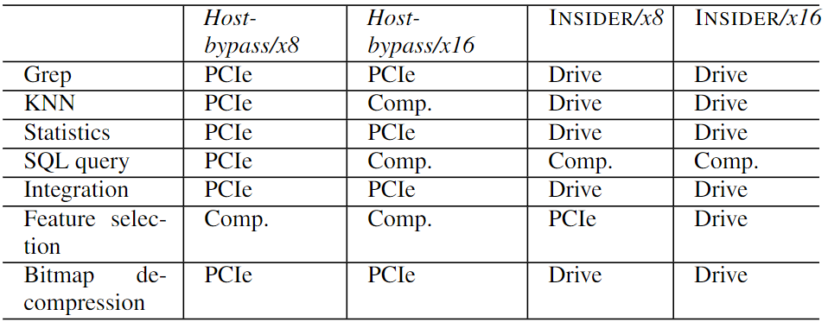
Evaluation
Bottleneck Analysis
For Host-bypass, limited PCIe bandwidth is the major bottleneck for the overall performance.
For most cases in INSIDER, the overall performance is bounded by the internal drive speed, which indicates that the optimal performance has been achieved.

Slide 17
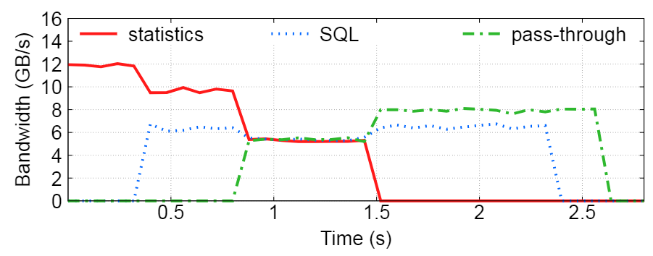
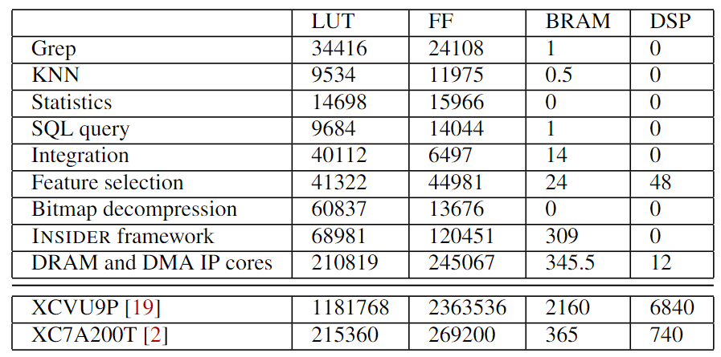
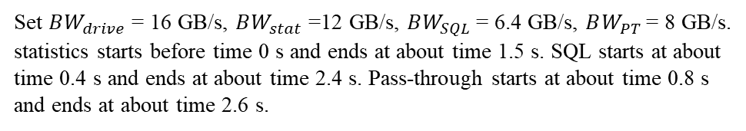
Evaluation
Simultaneous Multiprocessing and Resource Utilization
Set $BW_{drive}$ = 16 GB/s, $BW_{stat}$ =12 GB/s, $BW_{SQL}$ = 6.4 GB/s, $BW_{PT}$= 8 GB/s.
statistics starts before time 0 s and ends at about time 1.5 s. SQL starts at about time 0.4 s and ends at about time 2.4 s. Pass-through starts at about time 0.8 s and ends at about time 2.6 s.
Generally, an FPGA chip contains four types of resources: look-up tables (LUTs), flip-flops (FFs), block RAMs (BRAMs, which are SRAMbased), digital signal processors (DSPs).
Notes:
我们注意到DRAM和DMA ip核占据了总体资源消耗的主要部分。然而，这些组件实际上在现代存储驱动器[33]中已经存在(以ASIC硬IP的形式)，它也有一个内置的DRAM控制器，需要通过DMA与主机交互。因此，3只反映了由于我们的评估环境有限，只会在我们的原型中发生的资源使用。

Slide 18
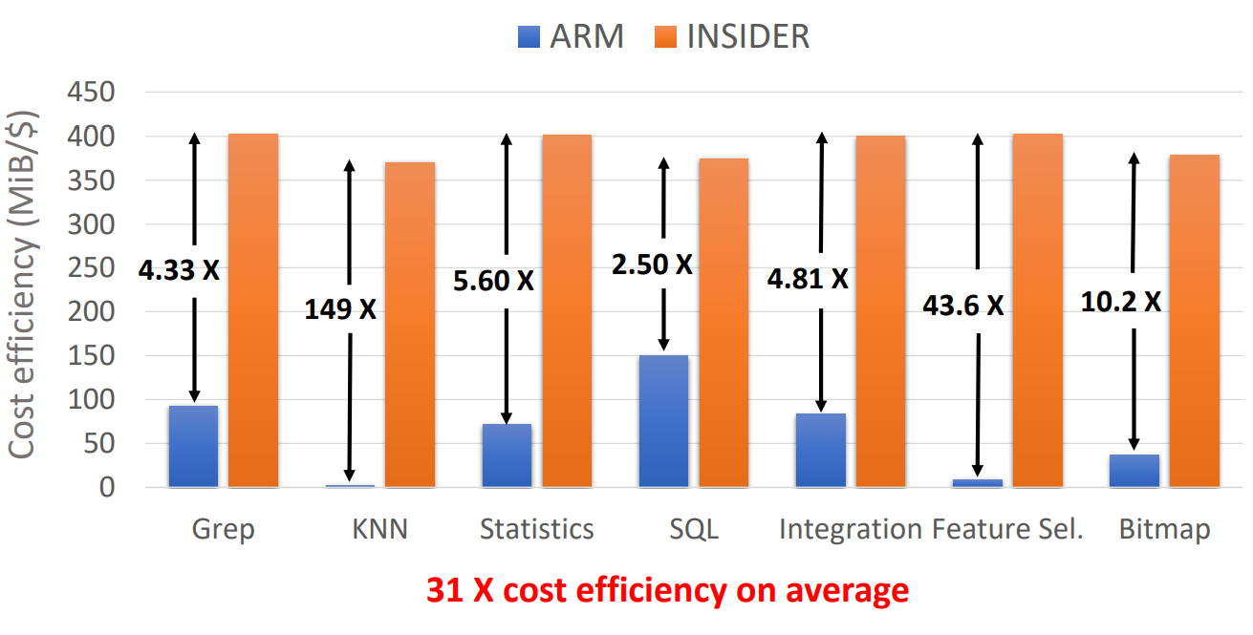
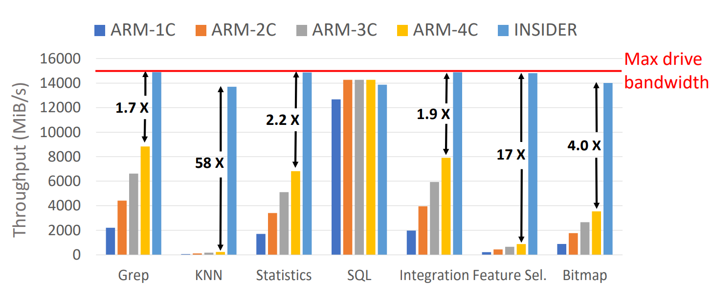
Evaluation
Comparing with the ARM-Based System

